Slide 1

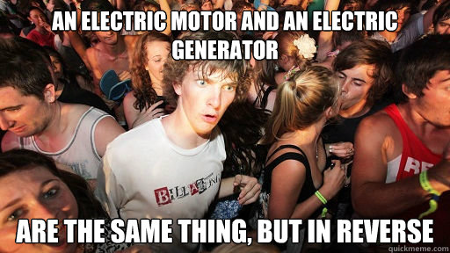
Magnetism and electricity day 3
9-27 & 9-28

Slide 2
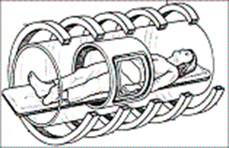
DQ
MRI machines use magnetic fields from powerful electromagnets to create images of the inside of a person’s body (see diagram below).
Magnetic Resonance Imaging
(MRI)
(Multi-Select Question) How are the electromagnets in a MRI machine similar to all other electromagnets, and how could a doctor increase a MRI machines’ magnetic field (Select two choices).
A. To increase the magnetic field strength, speed up the motion of the solenoid.
B. To increase the magnetic field of an MRI machine, increase the electrical current.
C. MRI machines consist of many permanent magnets that cannot be turned off.
D. They have coils of wire wrapped around iron cores connected to electrical current.
STND: 8PS2.1 & 8ETS1.1

Slide 3
Notebook check: Go to TEAMS and open the assignment. Use your notebook to answer the questions. You may not use your neighbors notebook.
Edpuzzles: Go to TEAMS and complete the assignment for the 3 Edpuzzles. Make sure to turn in when you are finished.
Blooket click here to play a review game
Work on or turn in any missing assignments. The end of the 9 weeks is Friday.

Slide 4
Exit Ticket:
What does a generator produce?
STND: 8PS2.1
STND: 8PS2.1 & 8ETS1.1

